Slide 1
Integument and its Derivatives

Slide 2
Integumententary Derivatives, Developmental Biology and Skeletal System
Integument and its derivatives
Human Osteology
Muscles of skeletal system
Developmental Biology of Chick

Slide 3
Integument (Skin)
Functions of Integument (Skin)
Protection
Provide the space for attachment of muscles
Glands (Soft derivatives)
Derivatives Hard- Hairs, horns, nails, Claws, Carapace and Plastron
Locomotion and movement
Pigmentation

Slide 4
General Structure of Integument
Epidermis
Stratum corneum
Stratum germinativum
Dermis
Stratum Spongiosum
Stratum Compactum
Hypodermis

Slide 5
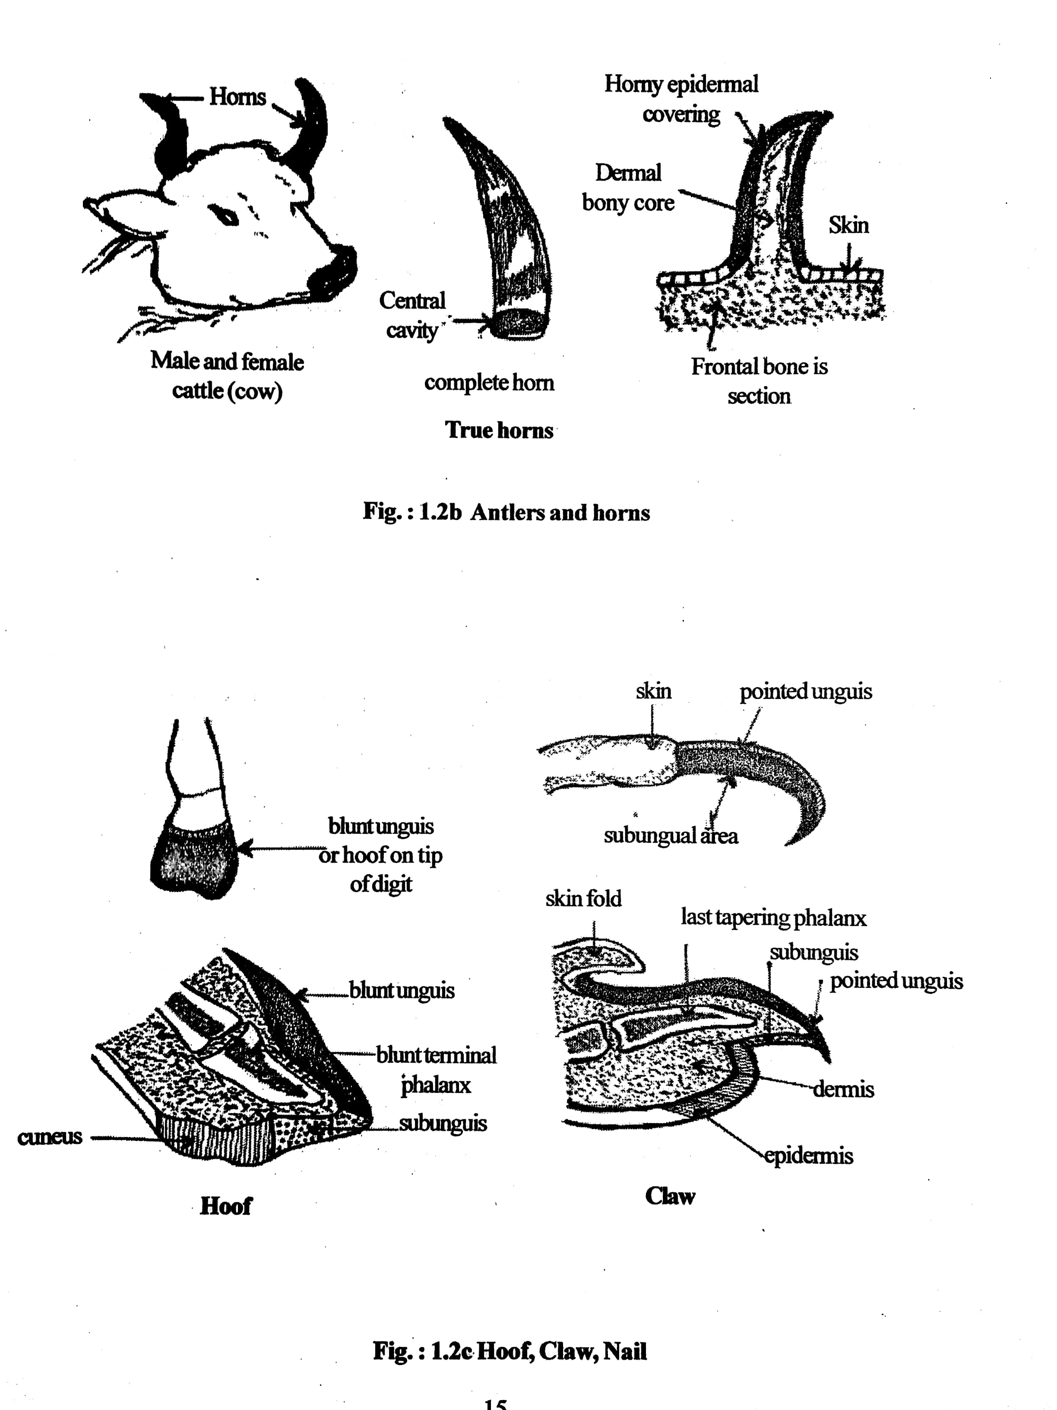
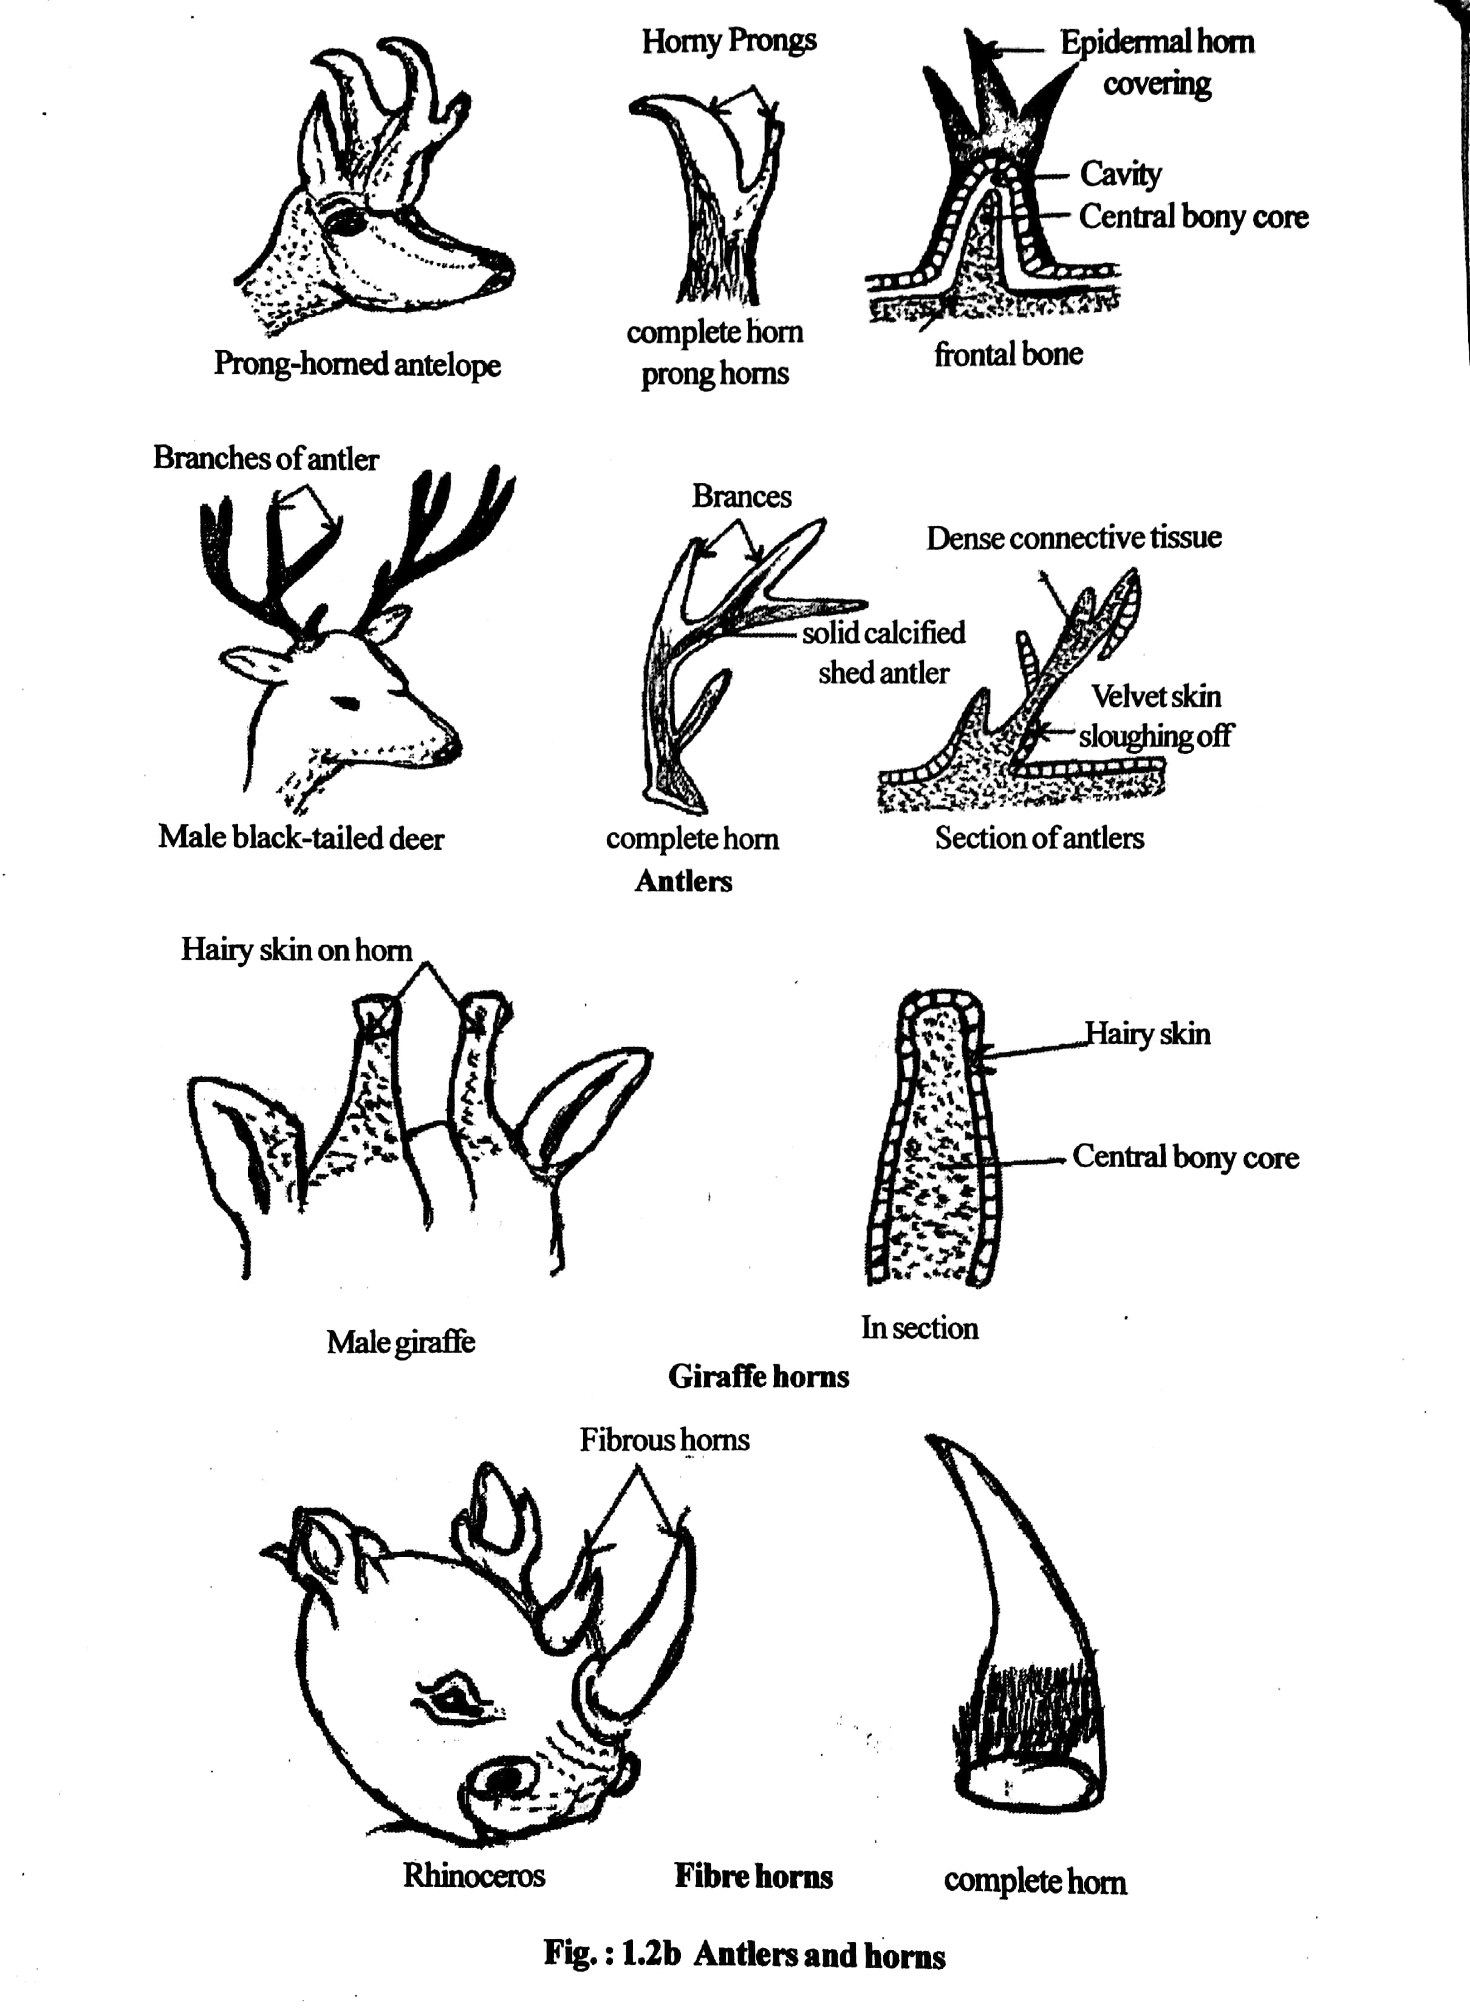
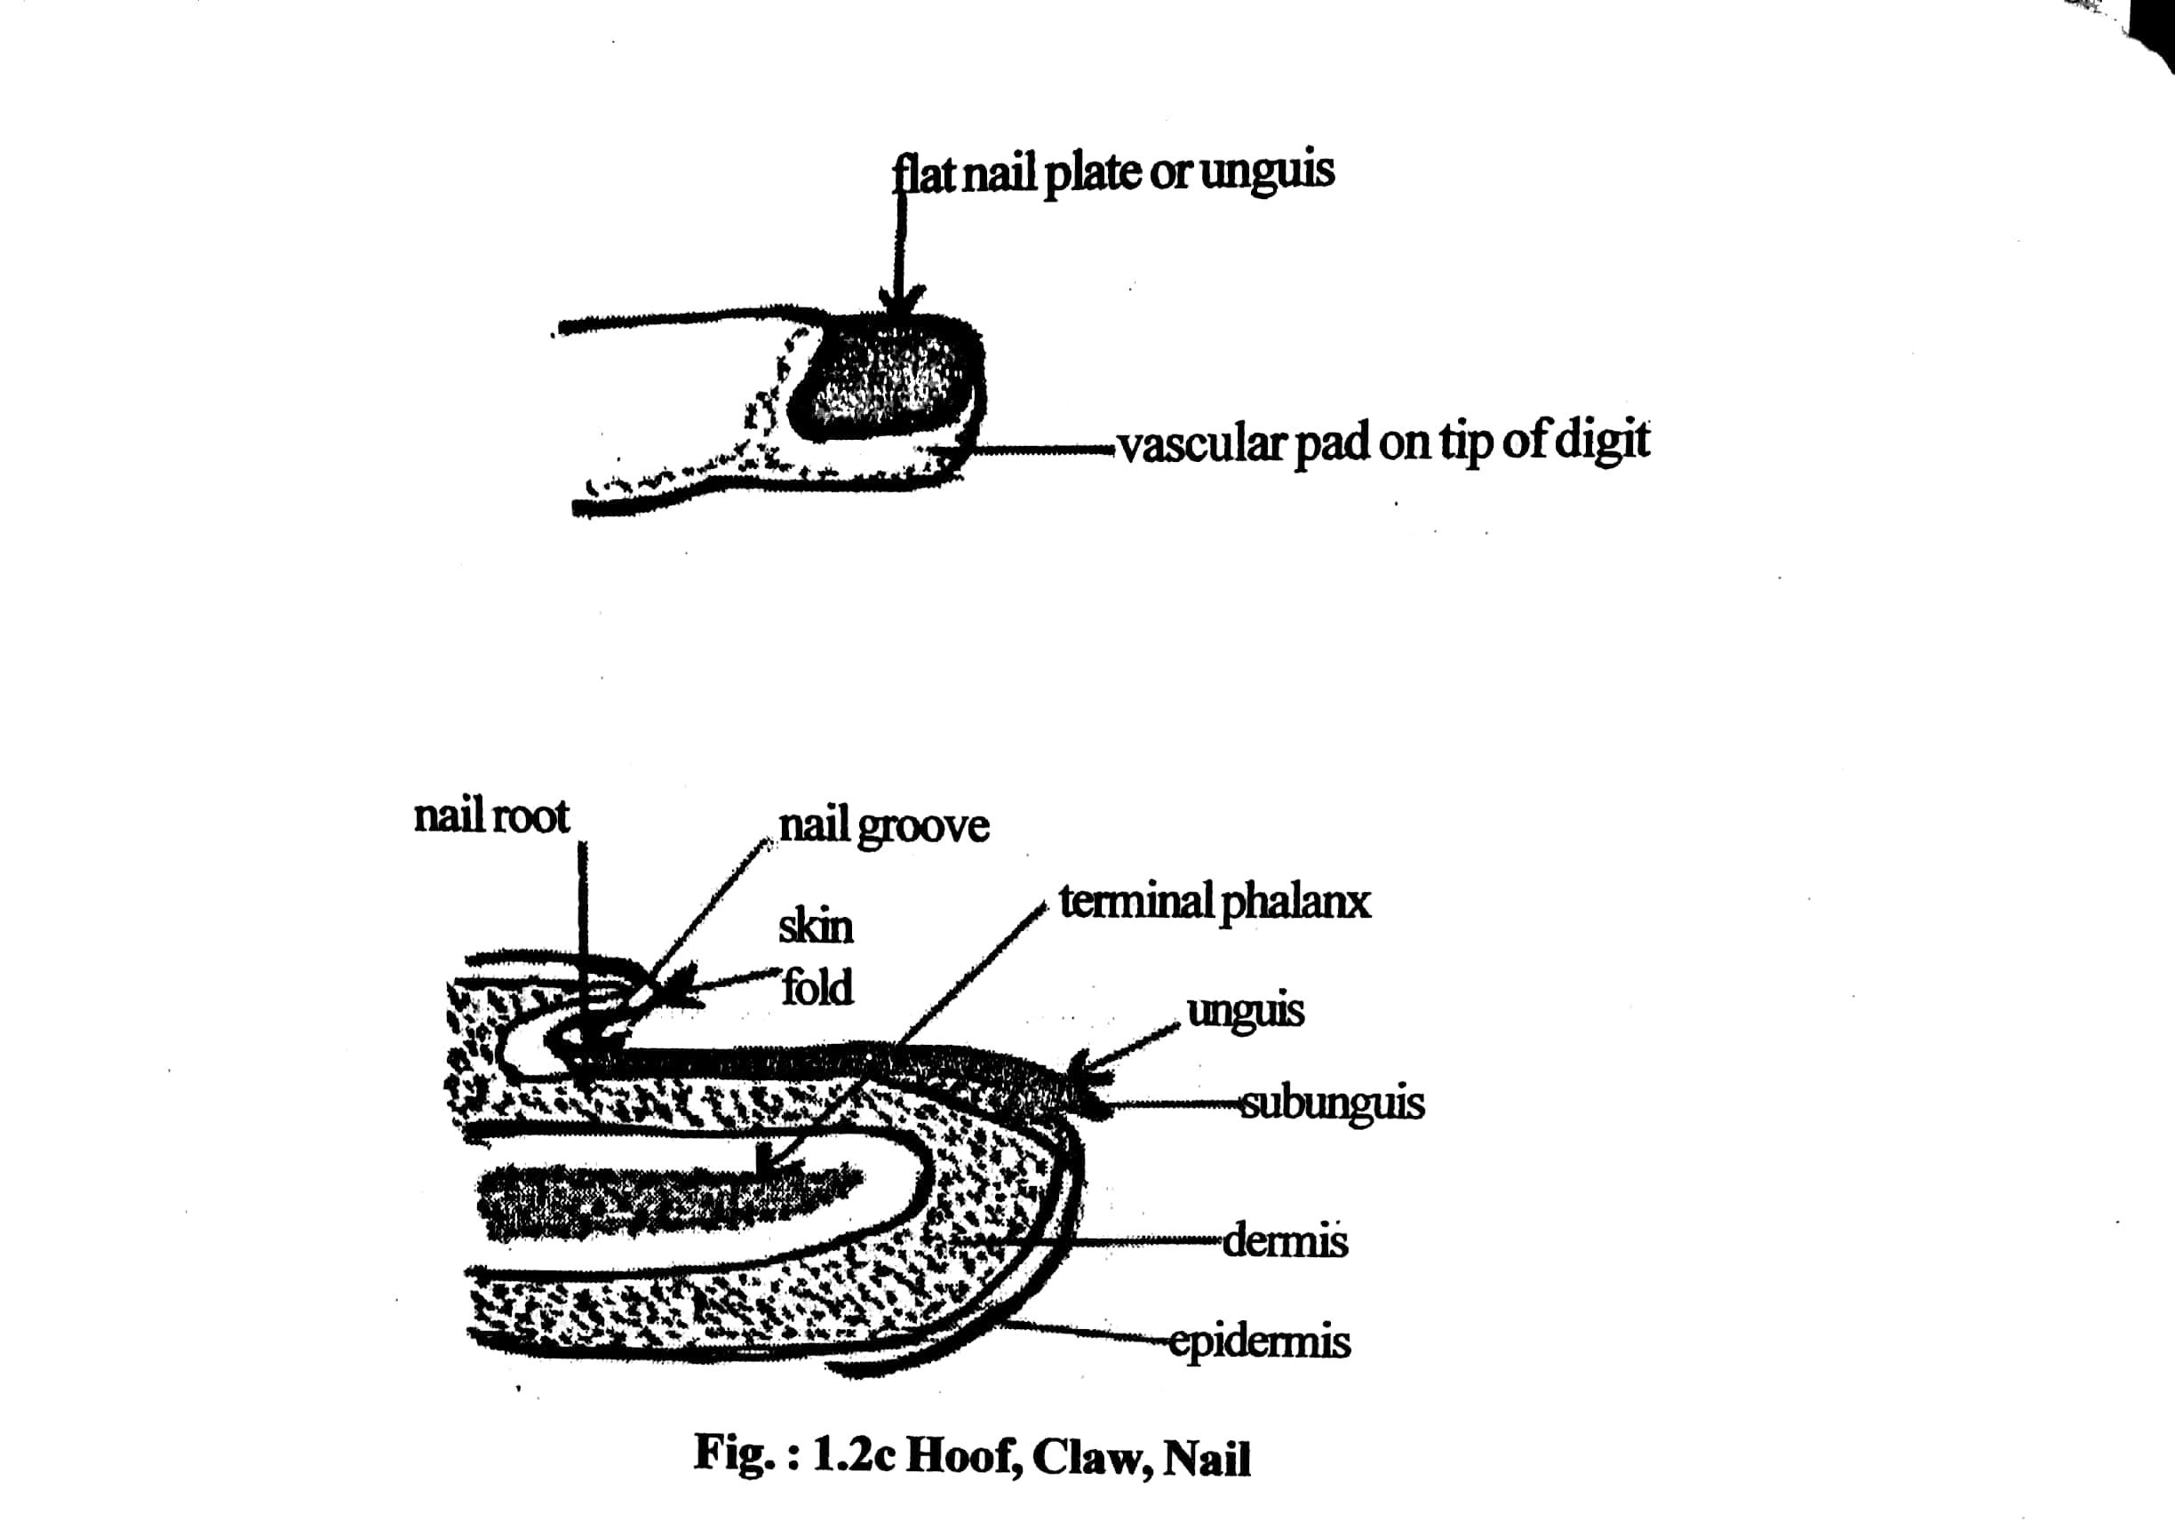
Derivatives of the Integument
Epidermal Derivatives
Epidermal Soft
Epidermal Hard
Dermis
Dermal Hard

Slide 6
Epidermal Hard Derivatives
Epidermal Scales
Horns
Claws
Nails
Hoof
Feathers
Hairs

